Slide 1
BIA - 660 - B
Web Analytics
Final Project
Sentiment Analysis of Airlines – United, Southwest and Virgin America

Slide 2
Team Members -
Paresh Maheshwari
Juhi Gurbani
Rishabh Jain

Slide 3

PROJECT OUTLINE
Text Mining -
Web scraping for tweets of different airlines – United, Southwest and Virgin America
Data preprocessing
Data Visualization
Sentiment Analysis
Classification
Analysis
Recommendations

Slide 4
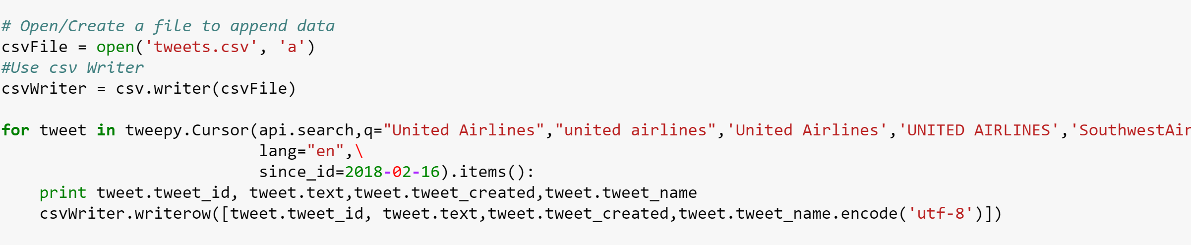
Text Mining : Web Scraping of Tweets
Technique employed for data extraction from websites
Library tweepy has been used to connect to Twitter API and download the data

Slide 5
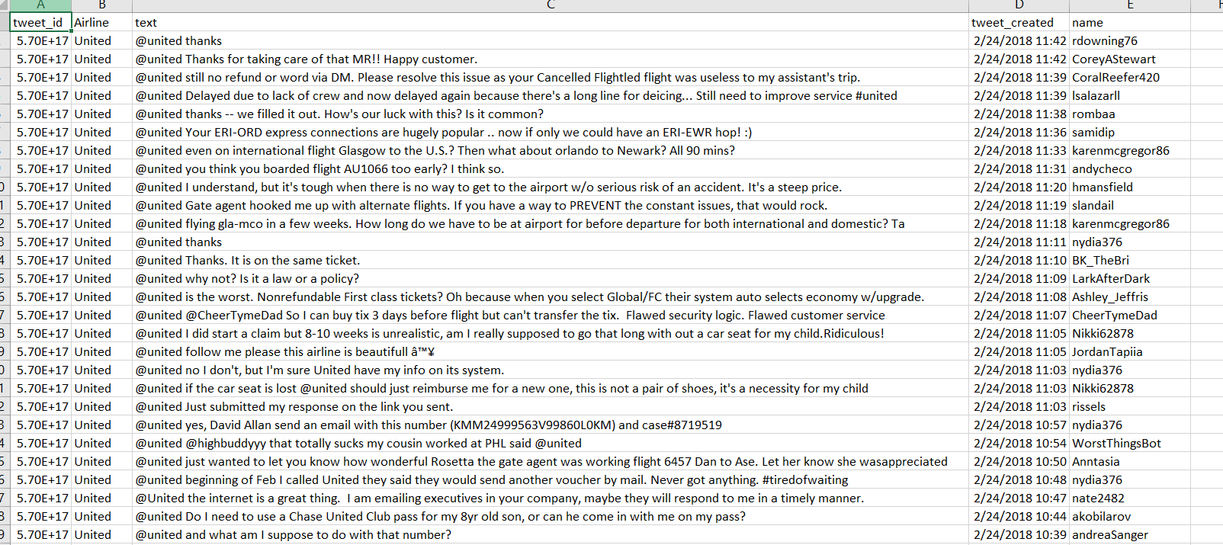
Text Mining : Web Scraping of Tweets

Slide 6
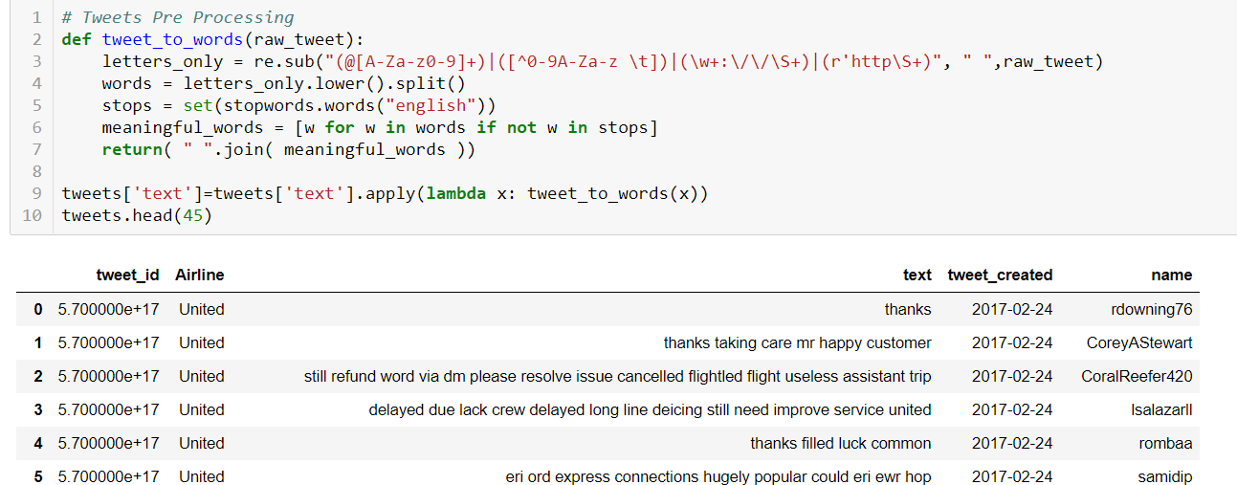
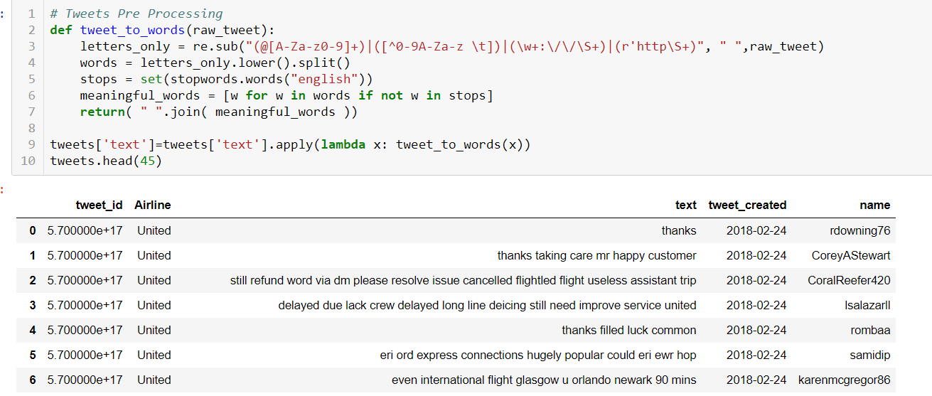
Text Pre Processing

Slide 7
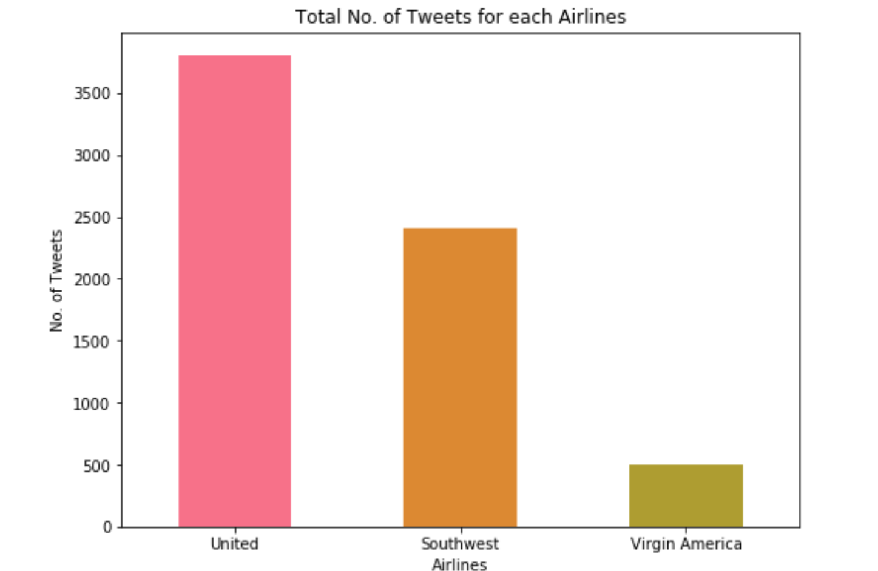
Data Visualization

Slide 8
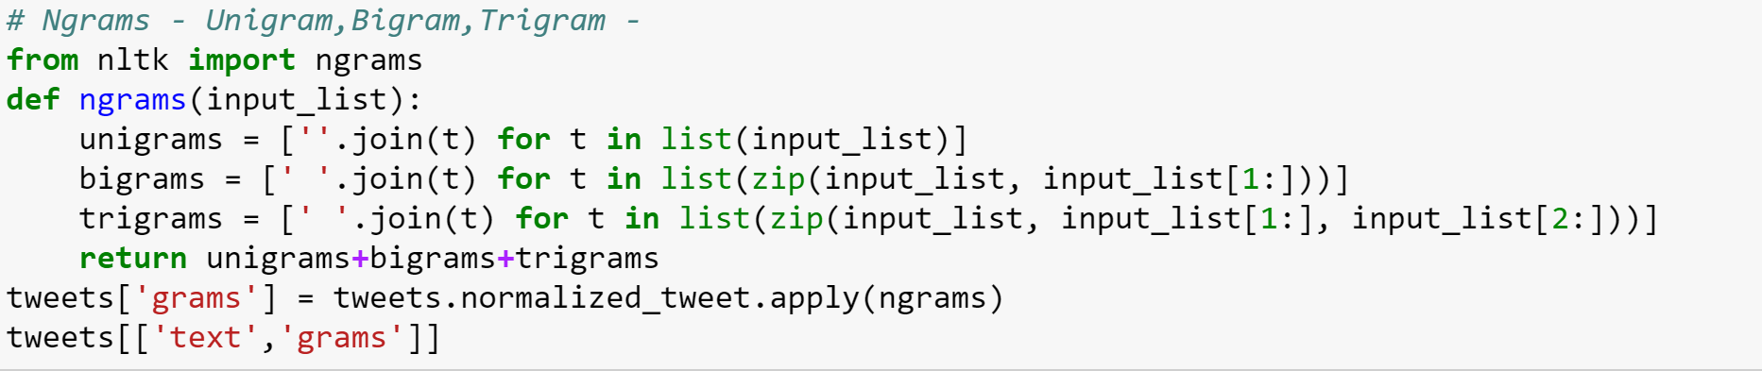
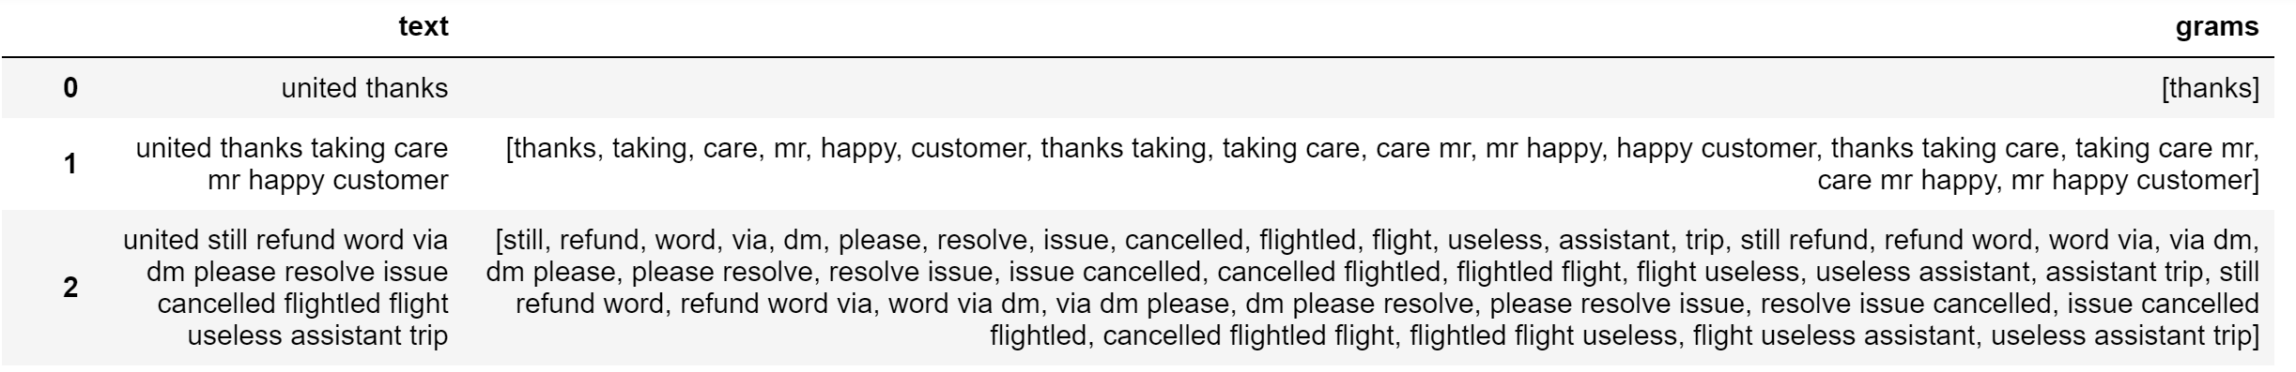
Data Preprocessing
Tokenization -
Unigram
Bigram
Trigram
Notes:
Need to change

Slide 9
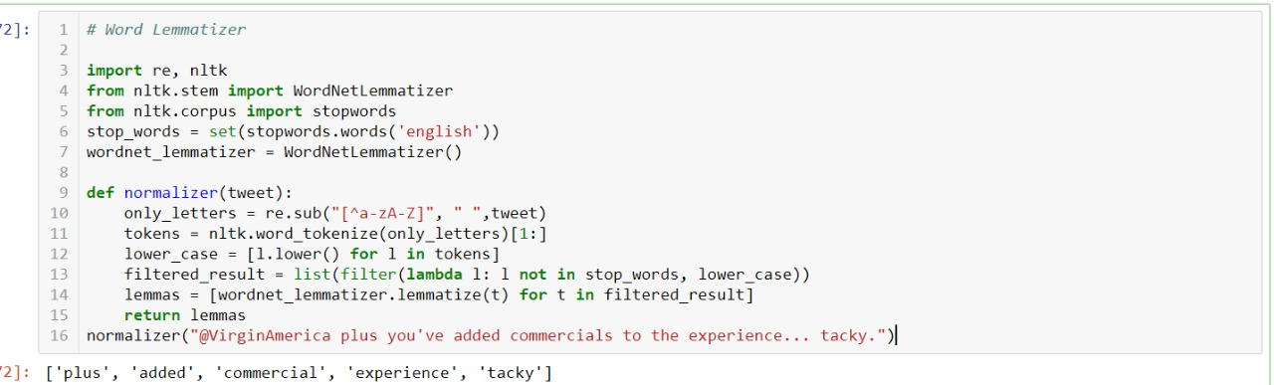
Data Preprocessing
Normalization - Lemmatization

Slide 10
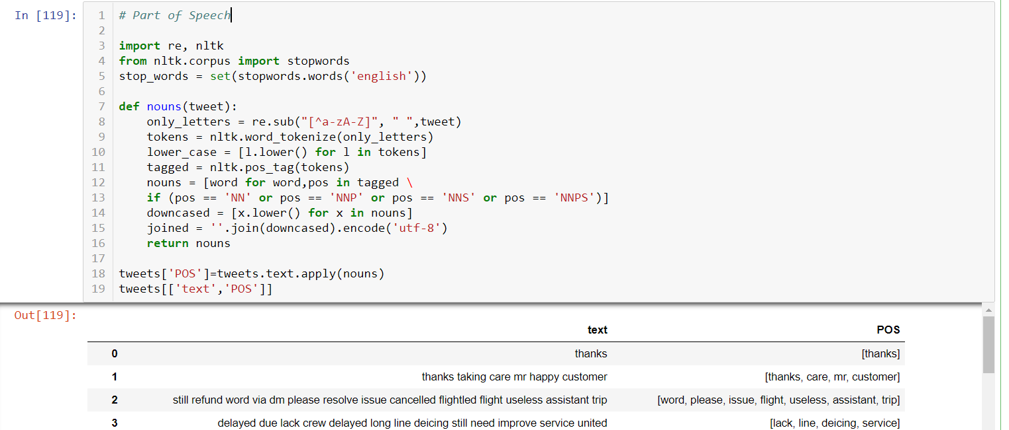
Data Preprocessing
Part-of-speech Tagging

Slide 11
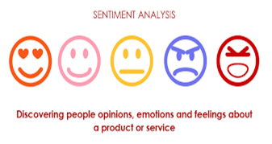
Sentiment Analysis
Determining a particular sentiment of a given text – positive, negative or neutral
It can identify the orientation of opinion in a piece of text
Can predict many different emotions – happiness, sadness, anger
Sentiment analysis is basically the process of determining the attitude or the emotion of the writer - positive or negative or neutral

Slide 12
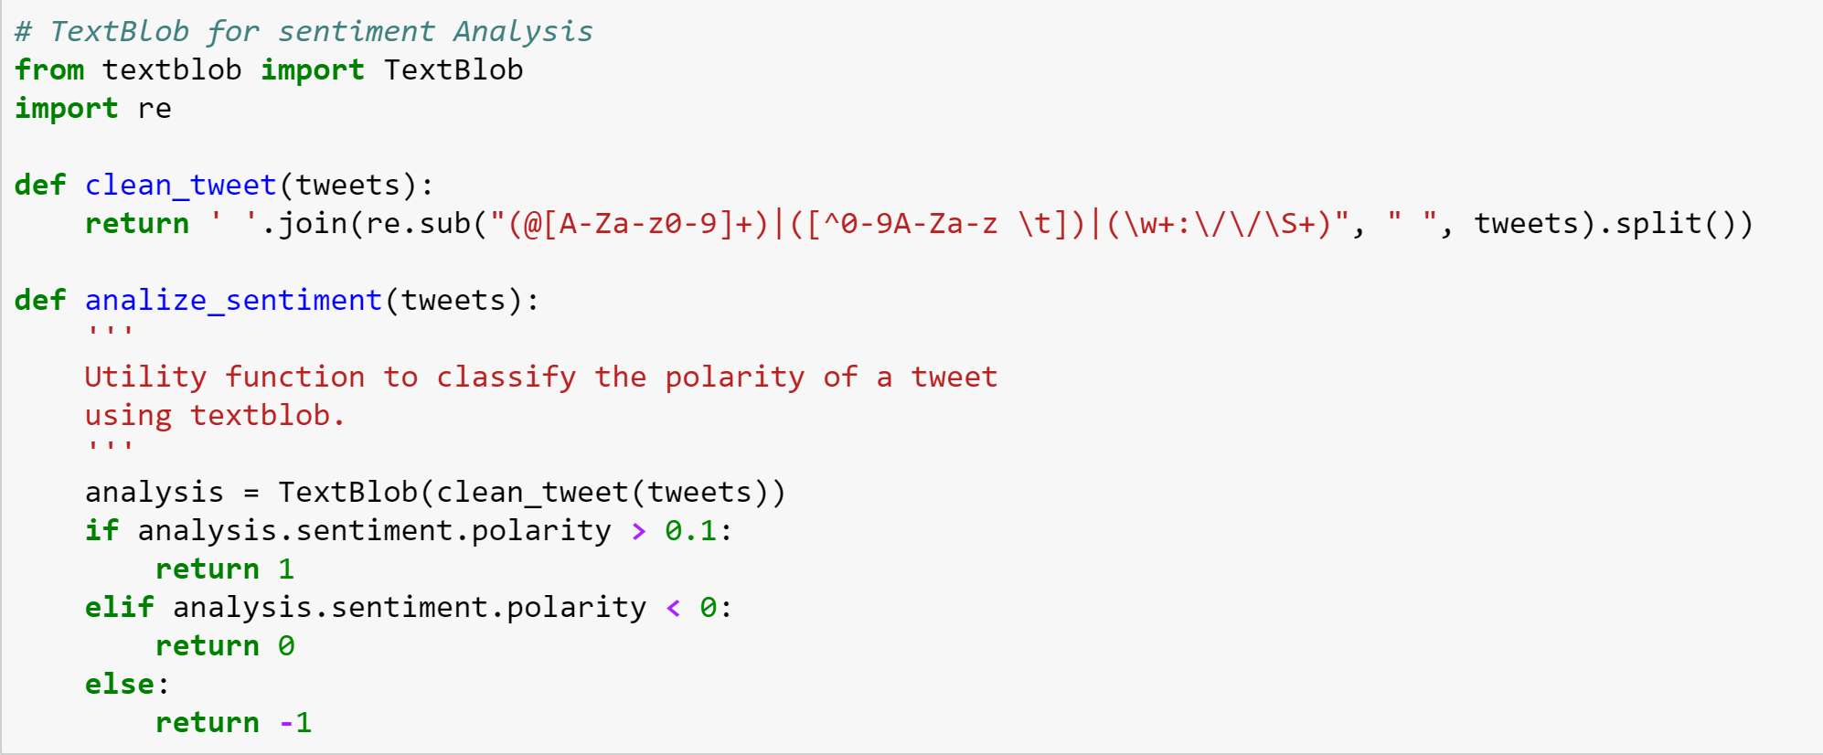
Sentiment Analysis
Sentiment analysis has been done using TextBlob - Python library for processing textual data
The sentiment function of TextBlob returns the polarity
Polarity is float which lies in the range of [-1,1]
1 - positive statement and 0 - negative statement

Slide 13
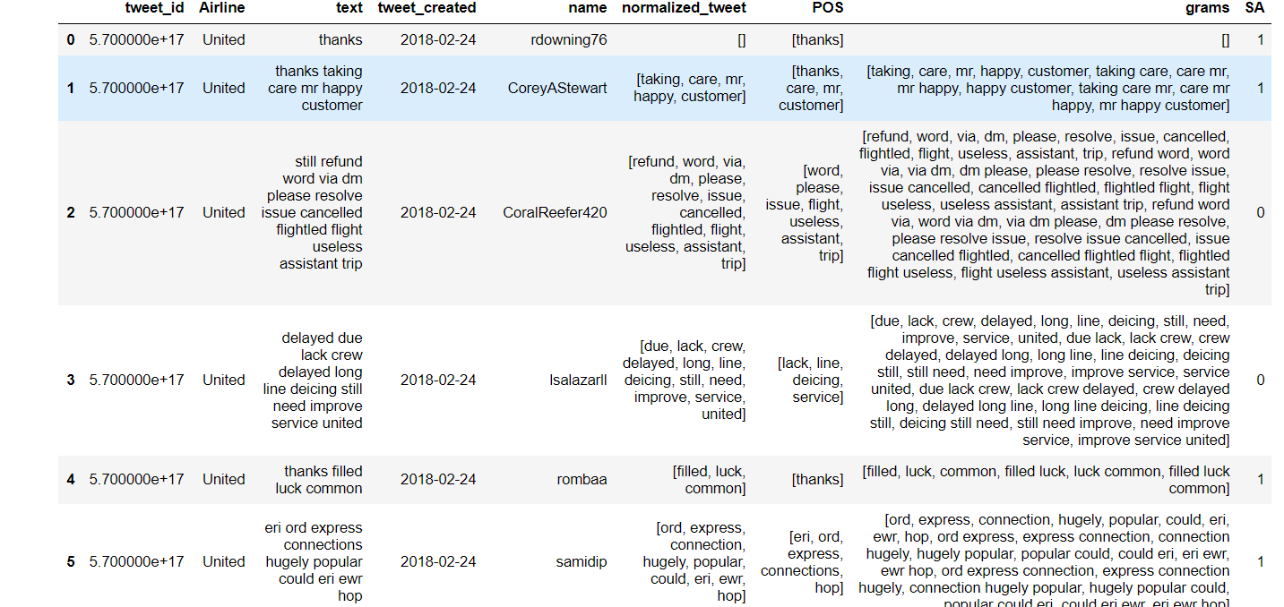
Sentiment Analysis
SA indicates the polarity of the tweet - positive(1) or negative(0)

Slide 14
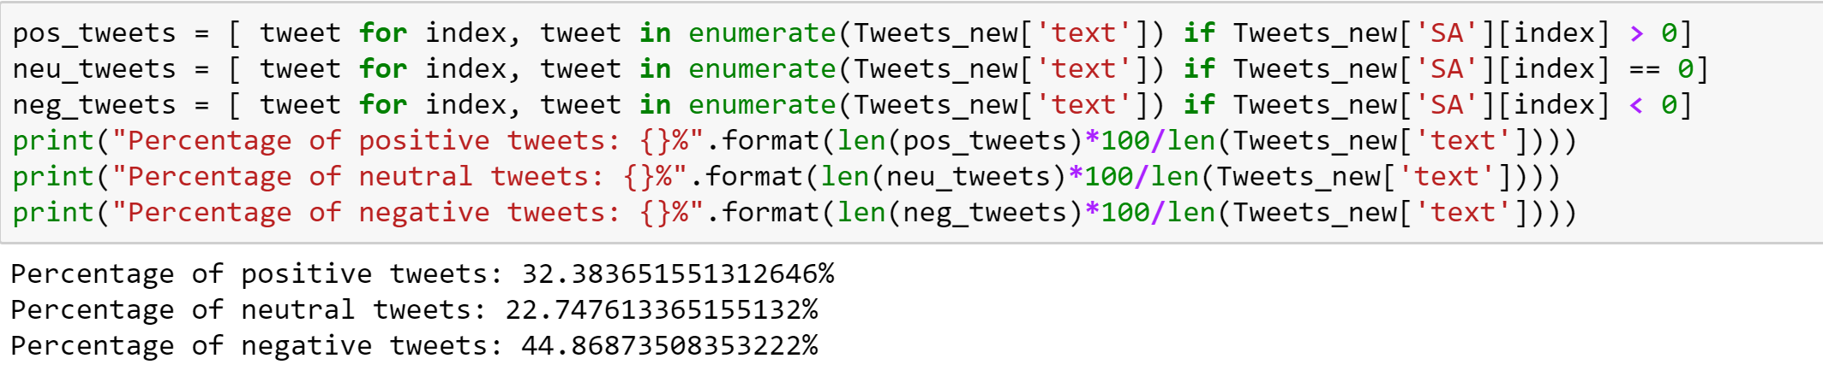
Sentiment Analysis Output - Textblob

Slide 15
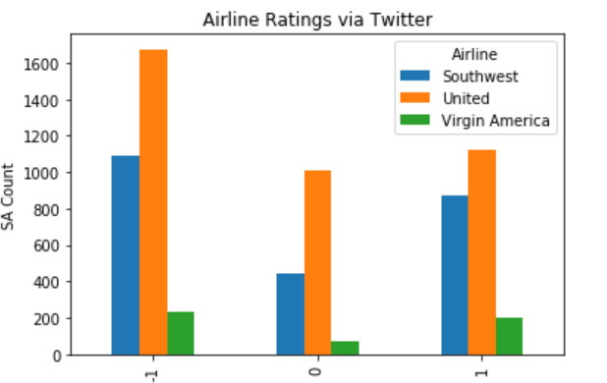
Sentiment Analysis Output - Textblob

Slide 16
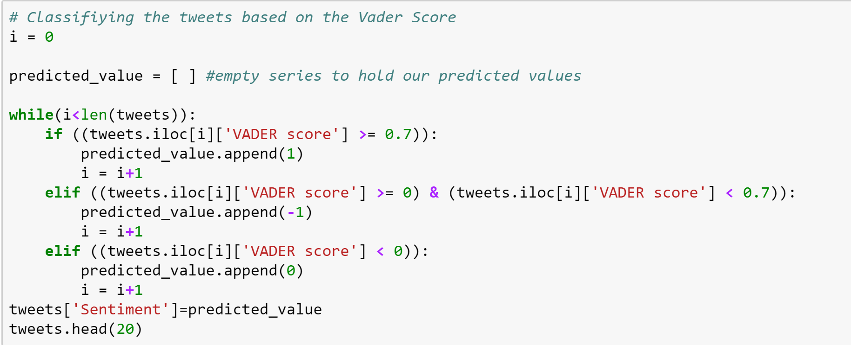
Sentiment Analysis - VADER
Sentiment analysis has been done using VADER as well

Slide 17
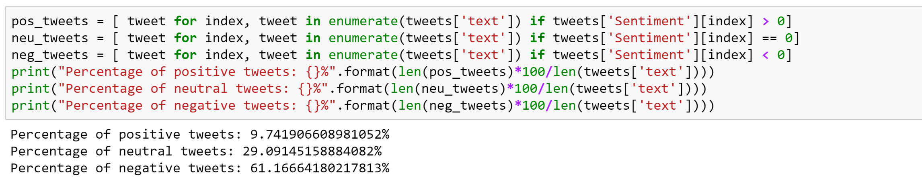
Sentiment Analysis Output - VADER

Slide 18
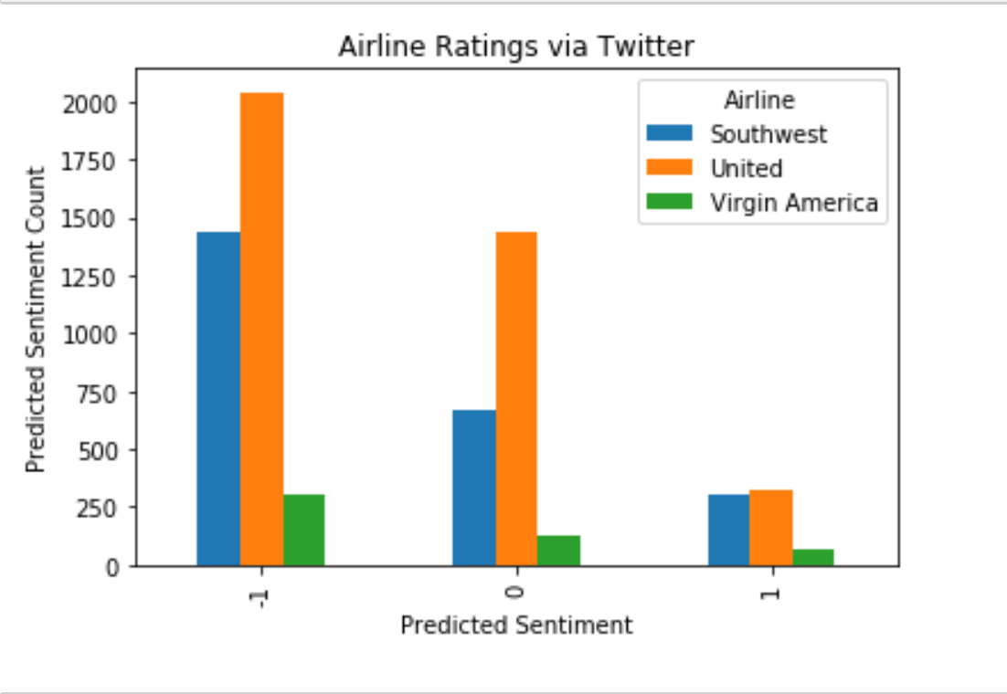
Sentiment Analysis Output - VADER

Slide 19
Sentiment Analysis Output - VADER
Airlines | Positive Sentiment | Negative Sentiment | Neutral Sentiment
UA | 8% | 54% | 38%
Southwest | 13% | 58% | 29%
Virgin America | 13% | 62% | 25

Slide 20
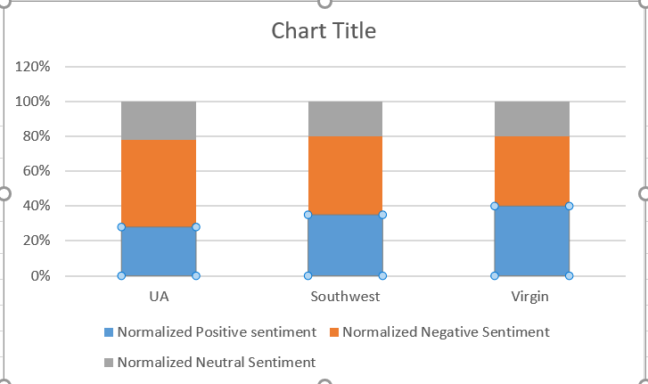
Sentiment Analysis Output - VADER

Slide 21
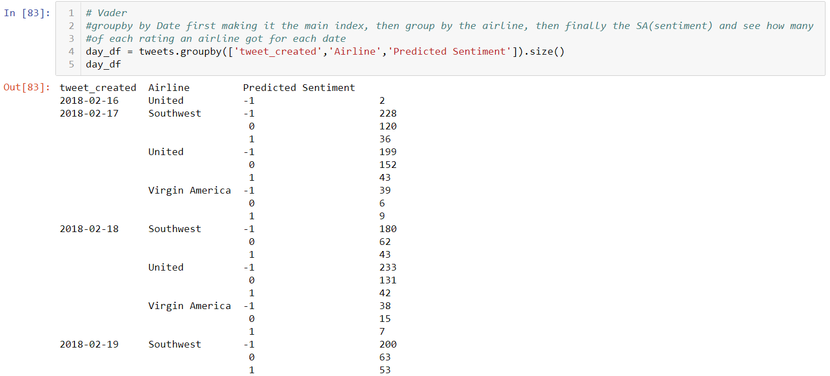

Slide 22
VADER
VADER as compared to TextBlob has a higher percentage of negative tweets.
It is because VADER doesn’t just do simple matching between the words in the text and in its lexicon.
It also considers certain things about the way the words are written as well as their context.
VADER recognizes capitalization, which increases the intensity of both positive and negative words.
It also recognizes exclamation marks. For example, ‘extremely bad’ would increase the negative intensity of a sentence, but ‘bad’ would decrease it.

Slide 23
VADER ADVANTAGES
Relatively simple algorithm and gives the freedom to understand the pipeline and customize it
VADER belongs to a type of sentiment analysis that is based on lexicons of sentiment-related words
VADER is a lexicon and rule-based sentiment analysis library, which works well even on short textual sentiments

Slide 24
TextBlob ADVANTAGES
TextBlob is a python library and offers a simple API to access its methods and perform basic NLP tasks
Things done with TextBlob -
Spelling correction
Creating a short summary of a text
Translation and language detection

Slide 25
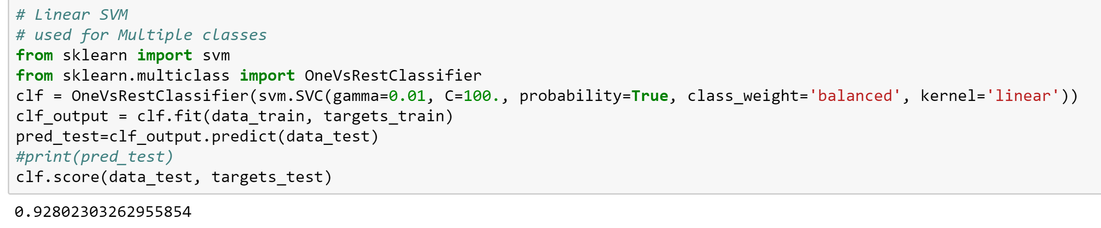
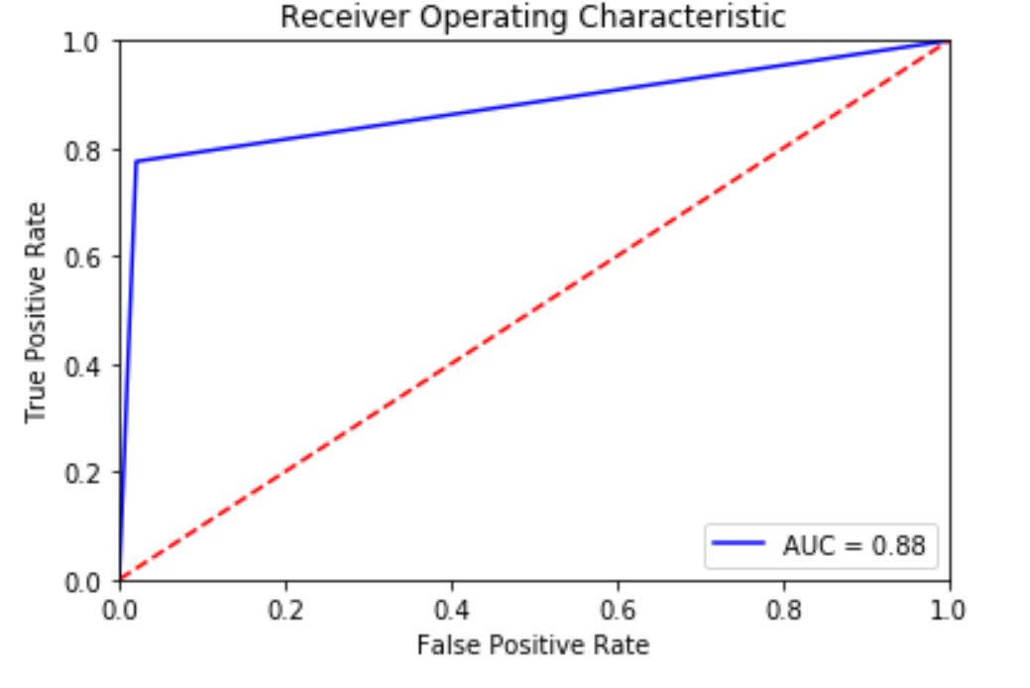
Linear Support Vector Machine
●One-vs-the-rest (OvR) multiclass/multilabel strategy -
●Fit one classifier per class
●Involves training a binary classifier for each class
●Each class predicts whether the instance belongs to the target class or not

Slide 26
Linear SVM Advantages
●Robust machine-learning algorithm to solve prediction problems as it maximizes margin
●SVMs are effective when the number of features is quite large
●Works well both on linear and non-linear data
●Handles high dimensional data well
●Works really well with clear margin of separation
●Effective in high dimensional spaces

Slide 27
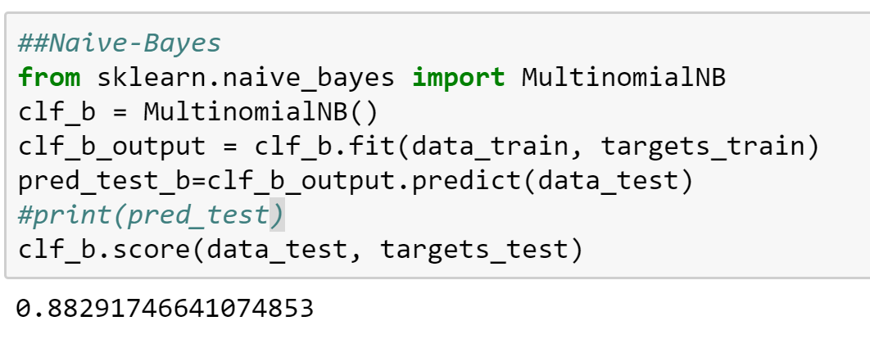
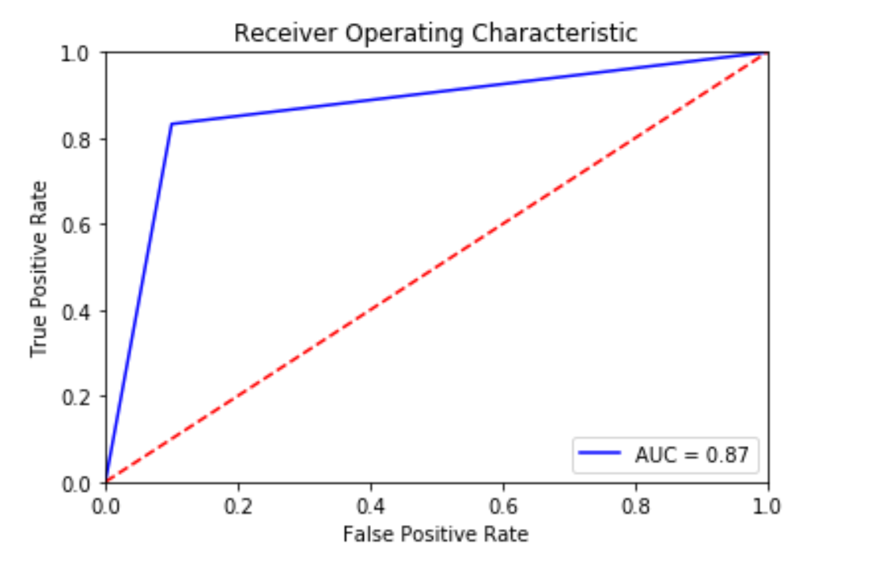
Naive Bayes
●Naive Bayes classification technique is based on the Bayesian theorem - finding functions describing the probability of belonging to a given class feature
●It aggregates information using conditional probability with an assumption of independence among features

Slide 28
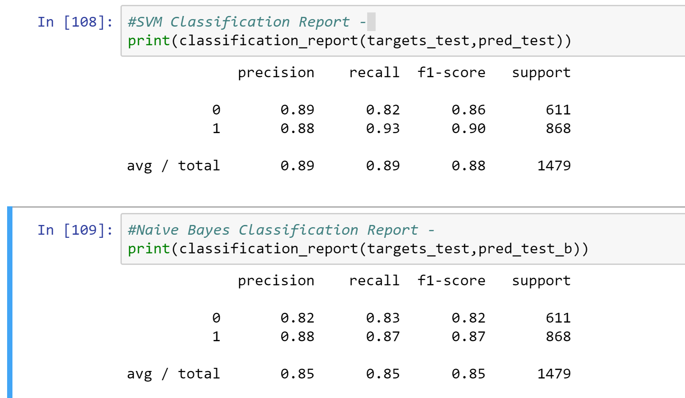
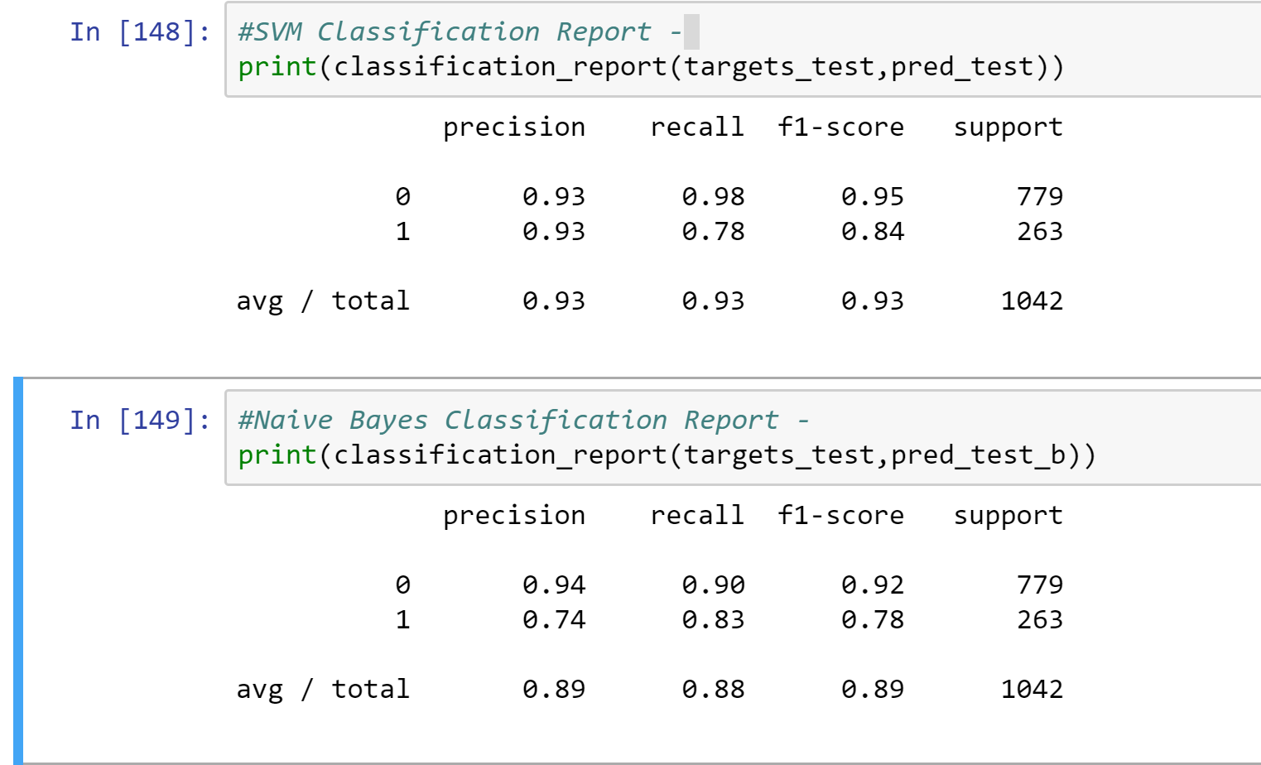
ANALYSIS
Sentiment Analysis - VADER Sentiment Analysis - TextBlob

Slide 29
Recommendations/ Conclusions
United airline has more traffic on its twitter handle than Southwest and Virgin America Airlines.
The point of concern for United airlines management should be the large extent of negative sentiment or usage of negative expressions by the users.
We can easily make out that 54% of the tweet concerning united airlines had negative sentiment in them while only 8% of had positive sentiment. This shows that half of their customer base is not satisfied by their performance or services and they need to rectify this issues like flight delays, baggage issues and customer service etc soon to retain their customers over a period of time.
United Airlines management can also train their social media team in being more proactive and sensitive towards users concern and encourage the use of personalized responses in place of scripted ones.

Slide 30
Future Scope
Airlines also have other social media platforms like Facebook and instagram where customers comment and express their emotions.
We intend to incorporate data from these other platforms to our existing database.
We will also be including the neutral comments in our dataset.

Slide 31
THANK YOU

